Slide 1


International Economics: Theory and Policy
Twelfth Edition
Chapter 5
Resources and Trade: The Heckscher-Ohlin Model
Copyright © 2022, 2018, 2015 Pearson Education, Inc. All Rights Reserved
Notes:
If this PowerPoint presentation contains mathematical equations, you may need to check that your computer has the following installed:
1) MathType Plugin
2) Math Player (free versions available)
3) NVDA Reader (free versions available)

Slide 2
Learning Objectives
5.1 Explain how differences in resources generate a specific pattern of trade.
5.2 Discuss why the gains from trade will not be equally spread even in the long run and identify the likely winners and losers.
5.3 Understand the possible links between increased trade and rising wage inequality in the developed world.
5.4 See how empirical patterns of trade and factor prices support some (but not all) of the predictions of the factor-proportions theory.

Slide 3
Preview
Production possibilities
Changing the mix of inputs
Relationships among factor prices and goods prices, and resources and output
Trade in the Heckscher-Ohlin model
Factor price equalization
Trade and income distribution
Empirical evidence

Slide 4
Introduction
In addition to differences in labor productivity, trade occurs due to differences in resources across countries.
The Heckscher-Ohlin theory argues that trade occurs due to differences in labor, labor skills, physical capital, capital, or other factors of production across countries.
Countries have different relative abundance of factors of production.
Production processes use factors of production with different relative intensity.

Slide 5
Two-Factor Heckscher-Ohlin Model
Two countries: home and foreign.
Two goods: cloth and food.
Two factors of production: labor and capital.
The mix of labor and capital used varies across goods.
The supply of labor and capital in each country is constant and varies across countries.
In the long run, both labor and capital can move across sectors, equalizing their returns (wage and rental rate) across sectors.

Slide 6
Production Possibilities (1 of 11)
With more than one factor of production, the opportunity cost in production is no longer constant and the P P F is no longer a straight line. Why?
Numerical example:
K = 3000, total amount of capital available for production
L = 2000, total amount of labor available for production

Slide 7
Production Possibilities (2 of 11)
Suppose use a fixed mix of capital and labor in each sector.
capital used to produce one yard of cloth
labor used to produce one yard of cloth
capital used to produce one calorie of food
labor used to produce one calorie of food

Slide 8
Production Possibilities (3 of 11)
Production possibilities describe different amounts of cloth and food that can be produced, given factor endowments and technology.
is total yards of cloth production
is total calories of food production

Slide 9
Production Possibilities (4 of 11)
Production possibilities are influenced by both capital and labor:
Capital used to produce cloth and food cannot exceed the supply of capital available.
Likewise, the labor used to produce cloth and food cannot exceed the supply of labor available.

Slide 10
Production Possibilities (5 of 11)
Constraint on capital that capital used cannot exceed supply for the numerical example:
Constraint on labor that labor used cannot exceed labor supply:

Slide 11
Production Possibilities (6 of 11)
Economy must produce subject to both constraints—that is, it must have enough capital and labor.
Without factor substitution, the production possibilities frontier is the interior of the two factor constraints.

Slide 12
Production Possibilities (7 of 11)
Max food production 1000 (point 1) fully uses capital, with excess labor.
Max cloth 1000 (point 2) fully uses labor, with excess capital.
Intersection of labor and capital constraints occurs at 500 calories of food and 750 yards of cloth (point 3).

Slide 13
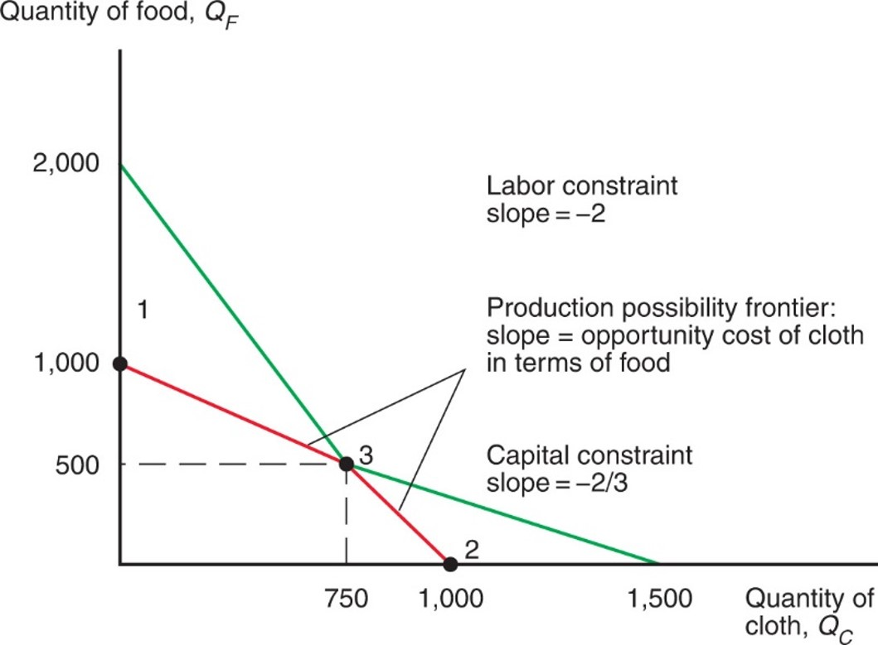
Figure 5.1 The Production Possibility Frontier without Factor Substitution
If capital cannot be substituted for labor or vice versa, the production possibility frontier in the factor-proportions model would be defined by two resource constraints: The economy can’t use more than the available supply of labor (2,000 work-hours) or capital (3,000 machine-hours). So the production possibility frontier is defined by the red line in this figure.
Notes:
Two lines fall from the y-axis to the x-axis. The first line falls from y = 2,000 to x = 1,000, which is point 2 on the x-axis. For the first line, labor constraint slope = negative 2. The second line falls from point 1, where y = 1,000, to x = 1,500. For the second line, capital constraint slope = negative two-thirds. The two lines intersect at point 3, (750, 500). The production possibility frontier slope = the opportunity cost of cloth in terms of food. The second line is highlighted to the left of point 3, when it is below the first line; the first line is highlighted to the right of point 3, when it is below the second line.

Slide 14
Production Possibilities (8 of 11)
The opportunity cost of producing one more yard of cloth, in terms of food, is not constant:
low
when the economy produces
a low amount of cloth and a high amount of food
high (2 in example) when the economy produces a high amount of cloth and a low amount of food
Why? Because when the economy devotes more resources towards production of one good, the marginal productivity of those resources tends to be low so that the opportunity cost is high.

Slide 15
Production Possibilities (9 of 11)
The above P P F equations do not allow substitution of capital for labor in production.
Unit factor requirements are constant along each line segment of the P P F.
If producers can substitute one input for another in the production process, then the P P F is curved (bowed).
Opportunity cost of cloth increases as producers make more cloth.

Slide 16
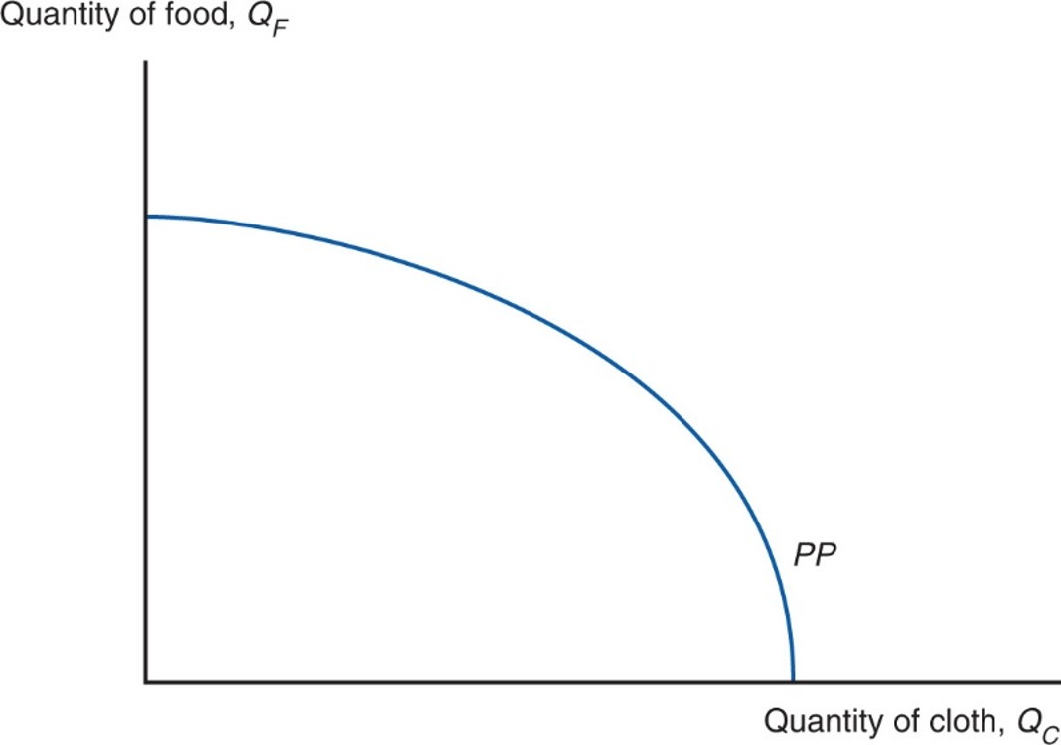
Figure 5.2 The Production Possibility Frontier with Factor Substitution
If capital can be substituted for labor and vice versa, the production possibility frontier no longer has a kink. But it remains true that the opportunity cost of cloth in terms of food rises as the economy’s production mix shifts toward cloth and away from food.

Slide 17
Production Possibilities (10 of 11)
What does the country produce?
The economy produces at the point that maximizes the value of production, V.
An isovalue line is a line representing a constant value of production, V:
where
are the prices of cloth and food.
slope of isovalue line is

Slide 18
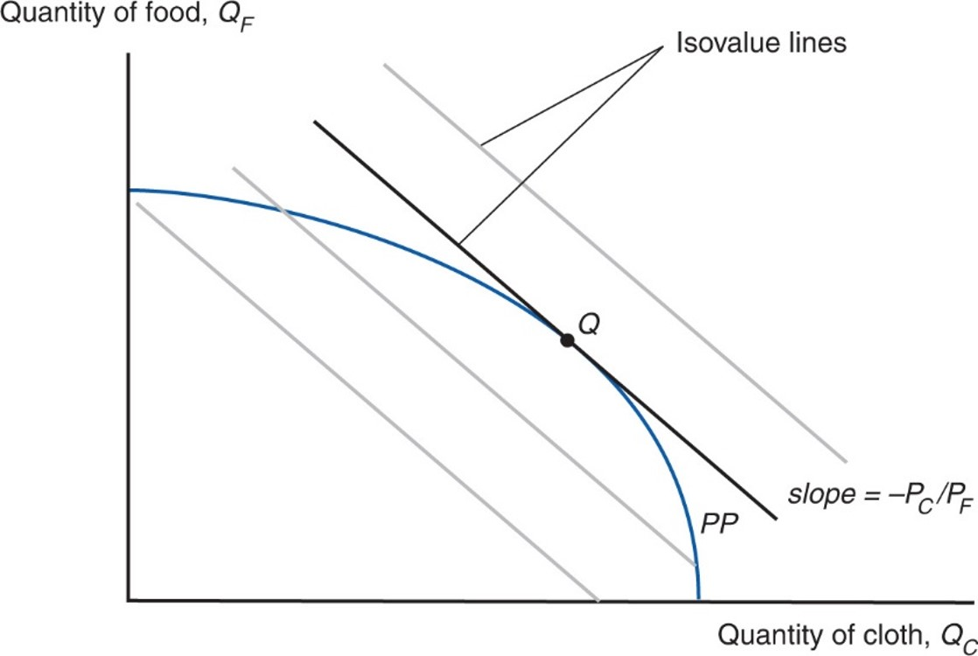
Figure 5.3 Prices and Production
The economy produces at the point that maximizes the value of production given the prices it faces; this is the point on the highest possible isovalue line. At that point, the opportunity cost of cloth in
terms of food is equal to the relative price of cloth,
Notes:
The P P curve falls with increasing steepness, through point Q, which is slightly closer to the x-axis than the y-axis. A line tangent to the curve at Q is an isovalue line, with slope = negative P sub C over P sub F. There are 2 more, parallel isovalue lines below the one that passes through Q, and another parallel isovalue line above it.

Slide 19
Production Possibilities (11 of 11)
Given the relative price of cloth, the economy produces at the point Q that touches the highest possible isovalue line.
At that point, the relative price of cloth equals the slope of the P P F, which equals the opportunity cost of producing cloth.
The trade-off in production equals the trade-off according to market prices.

Slide 20
Choosing the Mix of Inputs (1 of 2)
Producers may choose different amounts of factors of production used to make cloth or food.
Their choice depends on the wage, w, paid to labor and the rental rate, r, paid when renting capital.
As the wage w increases relative to the rental rate r, producers use less labor and more capital in the production of both food and cloth.

Slide 21
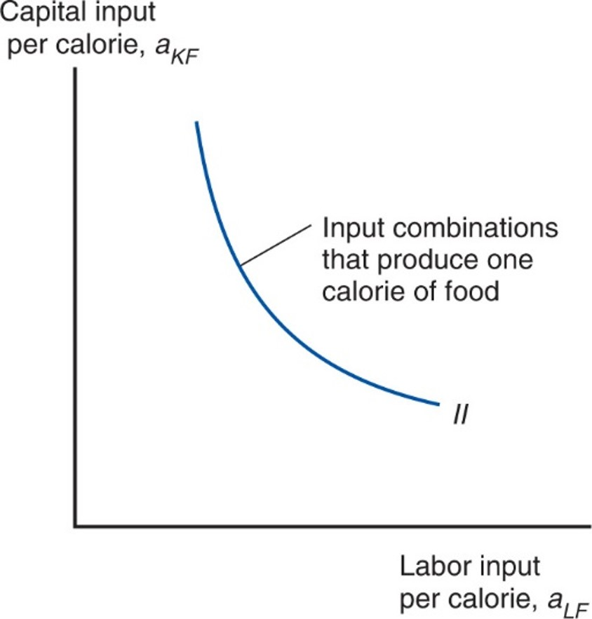
Figure 5.4 Input Possibilities in Food Production
A farmer can produce a calorie of food with less capital if he or she uses more labor, and vice versa.

Slide 22
Choosing the Mix of Inputs (2 of 2)
Assume that at any given factor prices, cloth production uses more labor relative to capital than food production uses:
Production of cloth is relatively labor intensive, while production of food is relatively land intensive.
Relative factor demand curve for cloth C C lies outside that for food F F.
Notes:
start fraction a sub start expression L C end expression over a sub start expression K C end expression end fraction is greater than start fraction a sub start expression L F end expression over a sub start expression K F end expression end fraction or start fraction L sub C over K sub C end fraction is greater than start fraction L sub F over K sub F end fraction

Slide 23
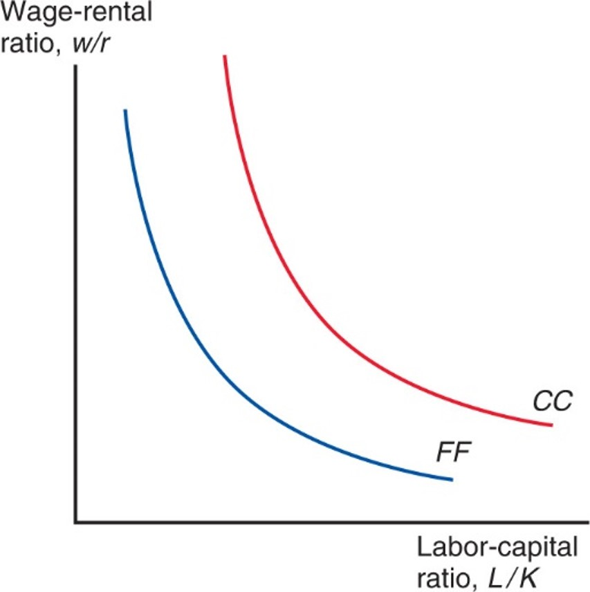
Figure 5.5 Factor Prices and Input Choices
At any given wage-rental ratio, cloth production uses a higher labor-capital ratio; when this is the case, we say that cloth production is labor-intensive and that food production is capital-intensive.

Slide 24
Factor Prices and Goods Prices (1 of 3)
In competitive markets, the price of a good should equal its cost of production, which depends on the factor prices.
How changes in the wage and rent affect the cost of producing a good depends on the mix of factors used.
An increase in the rental rate of capital should affect the price of food more than the price of cloth since food is the capital intensive industry.
Changes in
are tied to changes in

Slide 25
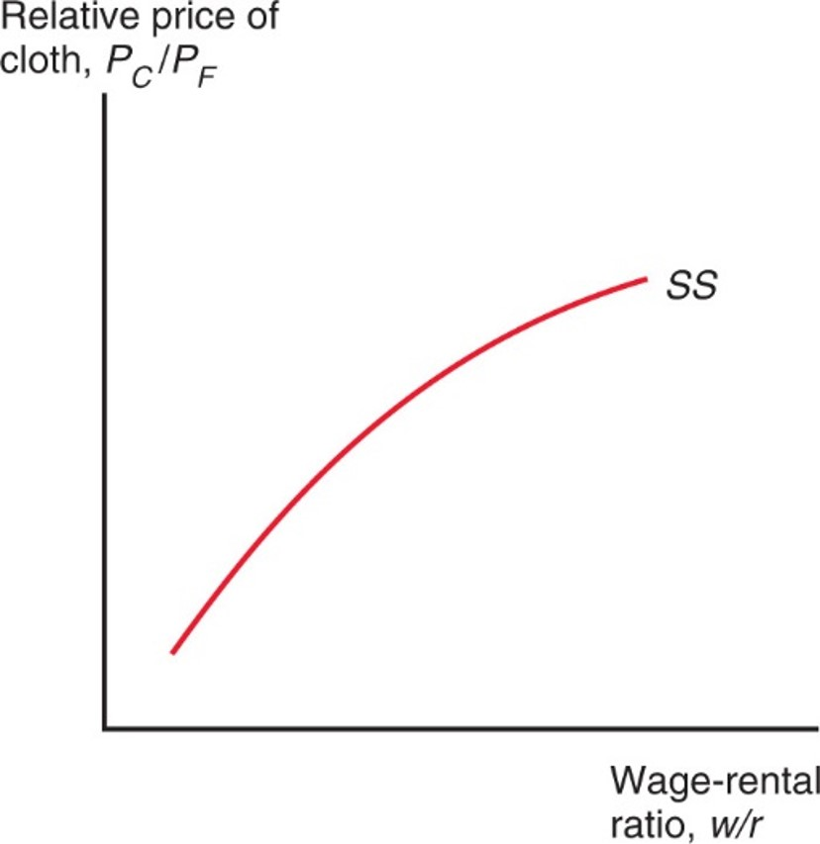
Figure 5.6 Factor Prices and Goods Prices
Because cloth production is labor-intensive while food production is capital-intensive, the higher the relative cost of labor, the higher must be the relative price of the labor-intensive good.

Slide 26
Factor Prices and Goods Prices (2 of 3)
Stolper-Samuelson theorem: If the relative price of a good increases, then the real wage or rental rate of the factor used intensively in the production of that good increases, while the real wage or rental rate of the other factor decreases.
Any change in the relative price of goods alters the distribution of income.

Slide 27
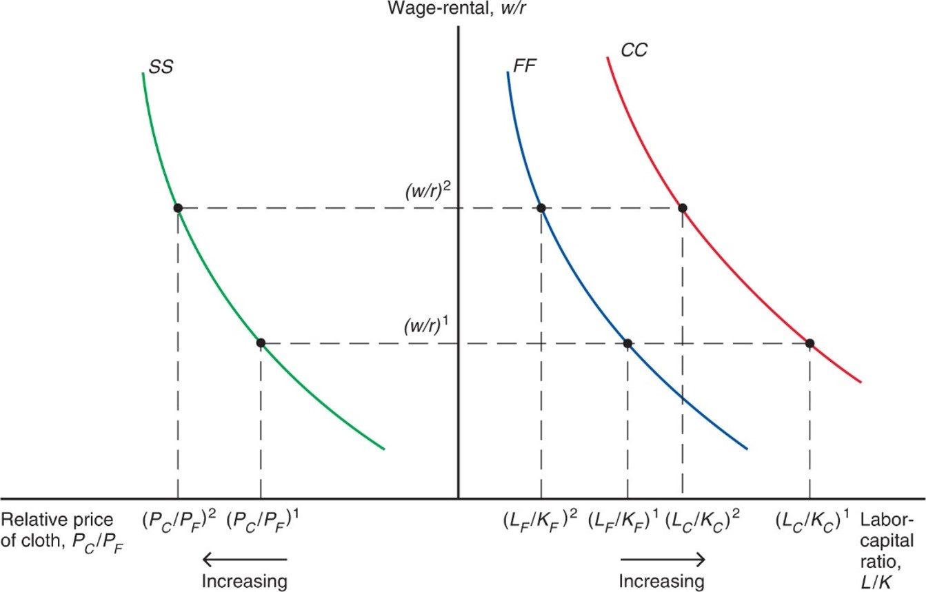
Figure 5.7 From Goods Prices to Input Choices
If the relative price of cloth rises, the wage-rental ratio must rise. This will cause the labor-capital ratio used in the production of both goods to drop.
Notes:
To the left of the y-axis, the x-axis shows relative price of cloth, P sub C over P sub F, which increases leftward. To the right of the y-axis, the x-axis shows labor-capital ratio, L over K, which increases rightward. The curve S S falls with decreasing steepness, to the left of the y-axis. Two curves, F F and C C, fall with decreasing steepness on the right side of the y-axis; curve F F is to the left of curve C C. All 3 curves pass through points at y = w over r, super 1, and a higher point at y = w over r, super 2; the x-axis points for each curve when y = w over r, super 2, are to the left of the x-axis points where y = w over r, super 1.

Slide 28
Factor Prices and Goods Prices (3 of 3)
An increase in the relative price of cloth,
is predicted to
raise income of workers relative to that of capital owners,
raise the ratio of capital to labor services,
used in
both industries.
raise the real income (purchasing power) of workers and lower the real income of capital owners.

Slide 29
Resources and Output (1 of 3)
How do levels of output change when the economy’s resources change?
Rybczynski theorem: If you hold output prices constant as the amount of a factor of production increases, then the supply of the good that uses this factor intensively increases and the supply of the other good decreases.

Slide 30
Resources and Output (2 of 3)
Assume an economy’s labor force grows, which implies
that its ratio of labor to capital
Expansion of production possibilities is biased toward cloth.
At a given relative price of cloth, the ratio of labor to capital used in both sectors remains constant.
To employ the additional workers, the economy expands production of the relatively labor-intensive good cloth and contracts production of the relatively capital-intensive good food.

Slide 31
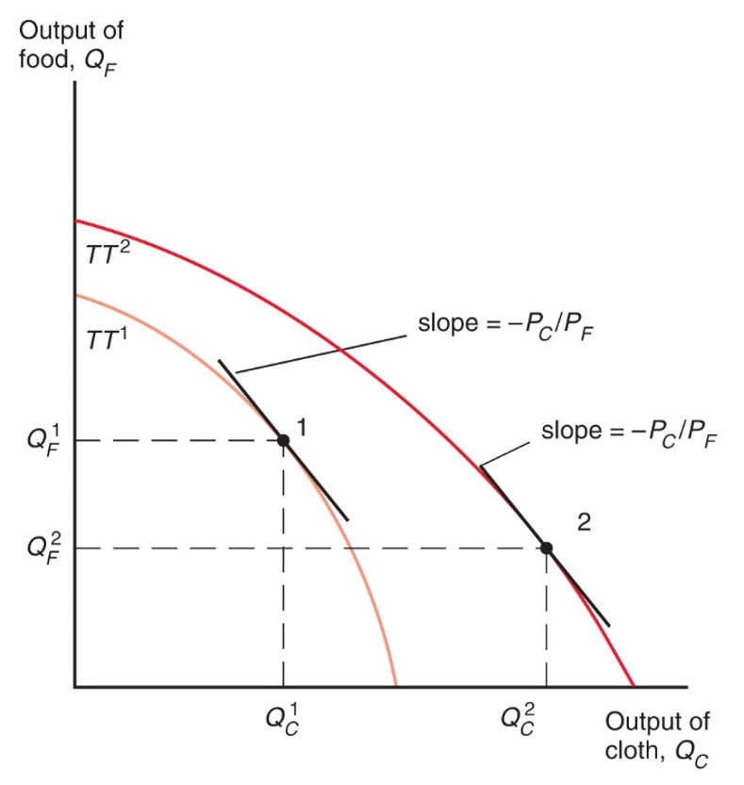
Figure 5.8 Resources and Production Possibilities
An increase in the supply of labor shifts the economy’s production possibility frontier outward disproportionately in the direction of cloth production. At an unchanged relative price of cloth, food production declines.
Notes:
The plot for T T super 1 falls with increasing steepness through point 1, at x = Q sub C super 1, y = Q sub F super 1. The slope at point 1 = negative P sub C over P sub F. The plot for T T super 2 begins higher on the y=axis than T T super 1, and falls with a more gradual decrease in steepness, to the right of T T super 1, through point 2. At point 2, x – Q sub C super 2, and y = Q sub F super 2. The slope at point 2 = negative P sub C over P sub F.

Slide 32
Resources and Output (3 of 3)
An economy with a high ratio of labor to capital produces a high output of cloth relative to food.
Suppose that Home is relatively abundant in labor and Foreign in capital:
Likewise, Home is relatively scarce in capital and Foreign in labor.
Home will be relatively efficient at producing cloth because cloth is relatively labor intensive.

Slide 33
Trade in the Heckscher-Ohlin Model (1 of 5)
The countries are assumed to have the same technology and the same tastes.
With the same technology, each economy has a comparative advantage in producing the good that relatively intensively uses the factors of production in which the country is relatively well endowed.
With the same tastes, the two countries will consume cloth to food in the same ratio when faced with the same relative price of cloth under free trade.

Slide 34
Trade in the Heckscher-Ohlin Model (2 of 5)
Since cloth is relatively labor intensive, at each relative price of cloth to food, Home will produce a higher ratio of cloth to food than Foreign.
Home will have a larger relative supply of cloth to food than Foreign.
Home’s relative supply curve lies to the right of Foreign’s.

Slide 35
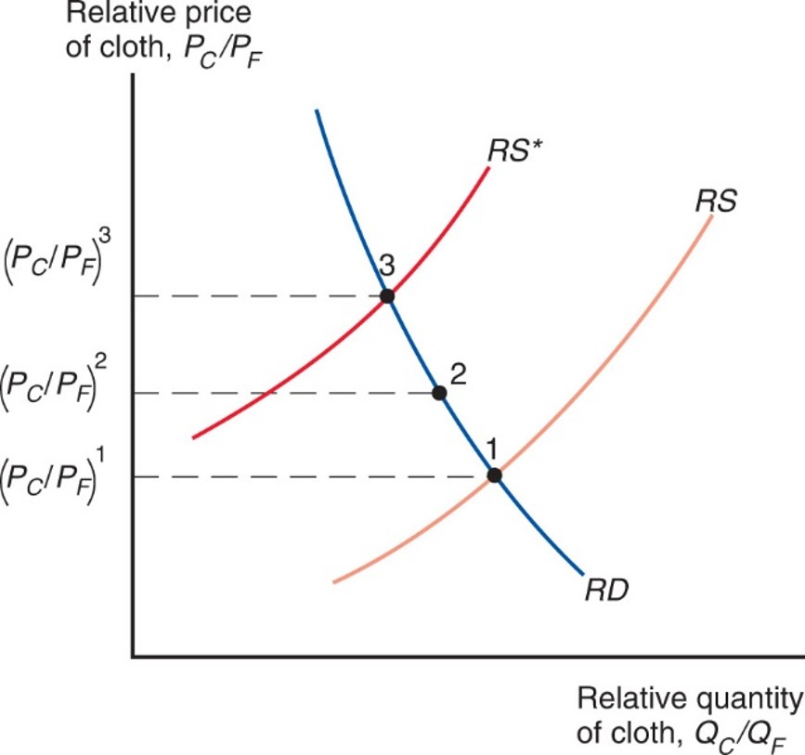
Figure 5.9 Trade Leads to a Convergence of Relative Prices
In the absence of trade, Home’s equilibrium would be at point 1, where domestic relative supply R S intersects the relative demand curve R D. Similarly, Foreign’s equilibrium would be at point 3. Trade leads to a world relative price that lies between the pretrade prices, such as at point 2.
Notes:
An R D curve falls with decreasing steepness from left to right. An R S curve rises with increasing steepness, and intersects the R D curve at point 1, where y = P sub C over P sub F, super 1. The plot for R S asterisk rises with parallel, increasing steepness above R S, and intersects R D at point 3, where y = P sub C over P sub F, super 3. Point 2 is plotted in the R D curve midway between points 3 and 1; at point 2, y = P sub C over P sub F, super 2.

Slide 36
Trade in the Heckscher-Ohlin Model (3 of 5)
Like the Ricardian model, the Heckscher-Ohlin model predicts a convergence of relative prices with trade.
With trade, the relative price of cloth rises in the relatively labor abundant (home) country and falls in the relatively labor scarce (foreign) country.

Slide 37
Trade in the Heckscher-Ohlin Model (4 of 5)
Relative prices and the pattern of trade: In Home, the rise in the relative price of cloth leads to a rise in the relative production of cloth and a fall in relative consumption of cloth.
Home becomes an exporter of cloth and an importer of food.
The decline in the relative price of cloth in Foreign leads it to become an importer of cloth and an exporter of food.

Slide 38
Trade in the Heckscher-Ohlin Model (5 of 5)
Heckscher-Ohlin theorem: The country that is abundant in a factor exports the good whose production is intensive in that factor.
This result generalizes to a correlation:
Countries tend to export goods whose production is intensive in factors with which the countries are abundantly endowed.

Slide 39
Trade and the Distribution of Income (1 of 5)
Changes in relative prices can affect the earnings of labor and capital.
A rise in the price of cloth raises the purchasing power of labor in terms of both goods while lowering the purchasing power of capital in terms of both goods.
A rise in the price of food has the reverse effect.

Slide 40
Trade and the Distribution of Income (2 of 5)
Thus, international trade can affect the distribution of income, even in the long run:
Owners of a country’s abundant factors gain from trade, but owners of a country’s scarce factors lose.
Factors of production that are used intensively by the import-competing industry are hurt by the opening of trade—regardless of the industry in which they are employed.

Slide 41
Trade and the Distribution of Income (3 of 5)
Compared with the rest of the world, the United States is abundantly endowed with highly skilled labor while low-skilled labor is correspondingly scarce.
International trade has the potential to make low-skilled workers in the United States worse off—not just temporarily, but on a sustained basis.

Slide 42
Trade and the Distribution of Income (4 of 5)
Changes in income distribution occur with every economic change, not only international trade.
Changes in technology, changes in consumer preferences, exhaustion of resources and discovery of new ones all affect income distribution.
Economists put most of the blame on technological change and the resulting premium paid on education as the major cause of increasing income inequality in the United States.
It would be better to compensate the losers from trade (or any economic change) than prohibit trade.
The economy as a whole does benefit from trade.

Slide 43
Trade and the Distribution of Income (5 of 5)
There is a political bias in trade politics: potential losers from trade are better politically organized than the winners from trade.
Losses are usually concentrated among a few, but gains are usually dispersed among many.
Each of you pays about $8/year to restrict imports of sugar, and the total cost of this policy is about $2 billion/year.
The benefits of this program total about $1 billion, but this amount goes to relatively few sugar producers.

Slide 44
North-South Trade and Income Inequality (1 of 4)
Over the last 40 years, countries such as South Korea, Mexico, and China have exported to the United States goods intensive in unskilled labor (e.g., clothing, shoes, toys, assembled goods).
At the same time, income inequality has increased in the United States , as wages of unskilled workers have grown slowly compared to those of skilled workers.
Did the former trend cause the latter trend?

Slide 45
North-South Trade and Income Inequality (2 of 4)
The Heckscher-Ohlin model predicts that owners of relatively abundant factors will gain from trade and owners of relatively scarce factors will lose from trade.
Little evidence supporting this prediction exists.
According to the model, a change in the distribution of income occurs through changes in output prices, but there is no evidence of a change in the prices of skill-intensive goods relative to prices of unskilled-intensive goods.

Slide 46
North-South Trade and Income Inequality (3 of 4)
According to the model, wages of unskilled workers should increase in unskilled labor abundant countries relative to wages of skilled labor, but in some cases the reverse has occurred:
Wages of skilled labor have increased more rapidly in Mexico than wages of unskilled labor.
But compared to the United States and Canada, Mexico is supposed to be abundant in unskilled workers.

Slide 47
North-South Trade and Income Inequality (4 of 4)
Even if the model were exactly correct, trade is a small fraction of the U.S. economy, so its effects on U.S. prices and wages prices should be small.
The majority view of trade economists is that the villain is not trade but rather new production technologies that put a greater emphasis on worker skills (such as the widespread introduction of computers and other advanced technologies in the workplace).

Slide 48
Skill-Biased Technological Change and Income Inequality (1 of 2)
Even though skilled labor becomes relatively more expensive, in panel (b) producers in both sectors respond to the skill-biased technological change by increasing their employment of skilled workers relative to unskilled workers.
The trade explanation in panel (a) predicts an opposite response for employment in both sectors.
A widespread increase in the skilled labor ratios for most sectors in the U.S. economy points to the skill-biased technological explanation.

Slide 49
Skill-Biased Technological Change and Income Inequality (2 of 2)
Trade likely has been an indirect contributor to increases in wage inequality, by accelerating the process of technological change.
Firms that begin to export may upgrade to more skill-intensive production technologies.
Trade liberalization can then generate widespread technological change by inducing a large proportion of firms to make such technology-upgrade choices.
Breaking up the production process across countries can increase the relative demand for skilled workers in developed countries similar to skill-biased technological change.

Slide 50
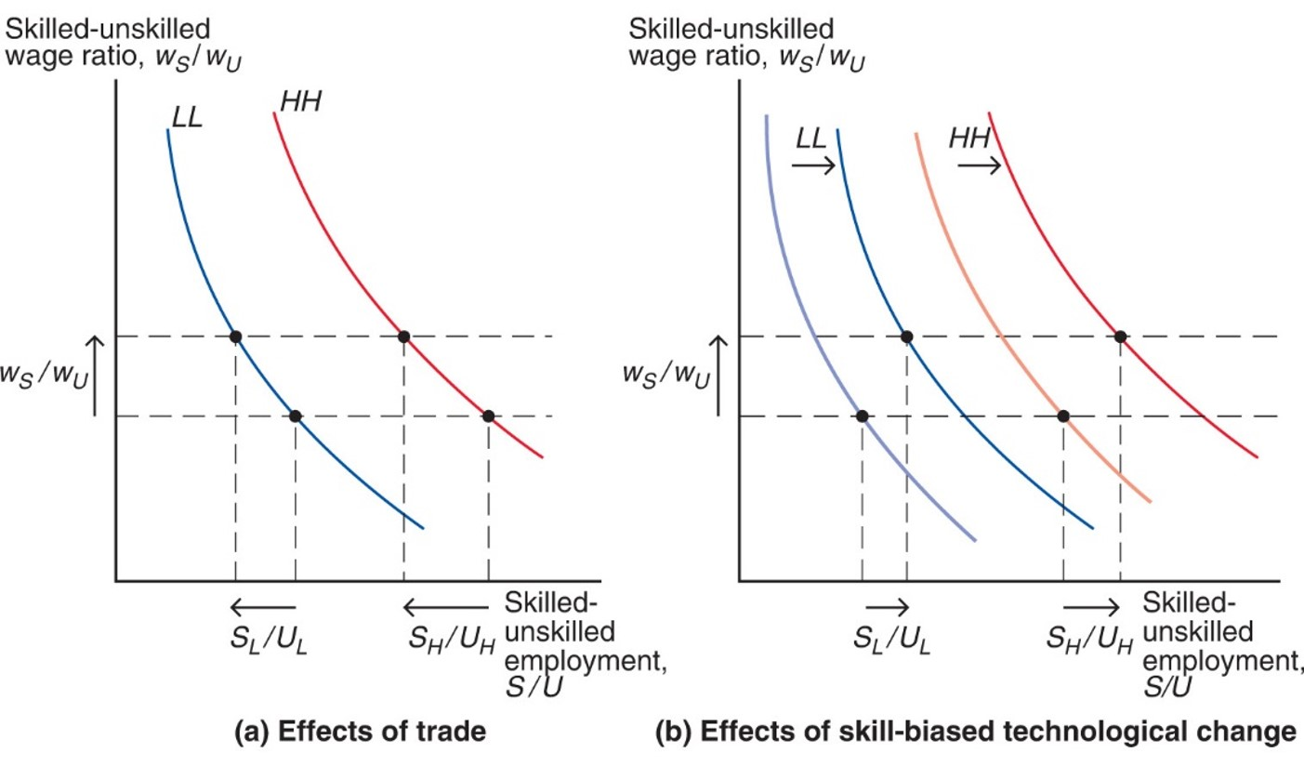
Figure 5.10 Increased Wage Inequality: Trade- or Skill-Biased Technological Change?
The L L and H H curves show the skilled-unskilled employment ratio as a function of the skilled-unskilled wage ratio in the low-tech and high-tech sectors. The high-tech sector is more skill-intensive than the low-tech sector, so the H H curve is shifted out relative to the L L curve.
Notes:
Graph ay, for the effects of trade, has two curves that fall with decreasing steepness. Curve L L falls through 2 points; w sub s over w sub u increases from the lower point to the higher point; and S sub L over U sub L increases from right to left between the points. Curve H H, to the right of L L, falls through 2 points; w sub s over w sub u increases from the lower point to the higher point; and S sub H over U sub H increases from right to left between the points. Graph b, for the effects of skill-biased technological change, has 4 plots, as it shifts the curves for L L and H H to the right. For the curve L L, w sub s over w sub u increases from the lower point, on the left curve, to the higher point, on the right curve; S sub L over U sub L increases from left to right between the points. For curve H H, w sub s over w sub u increases from the lower point, on the left curve, to the higher point, on the right curve; S sub H over U sub H increases from left to right between the points.

Slide 51
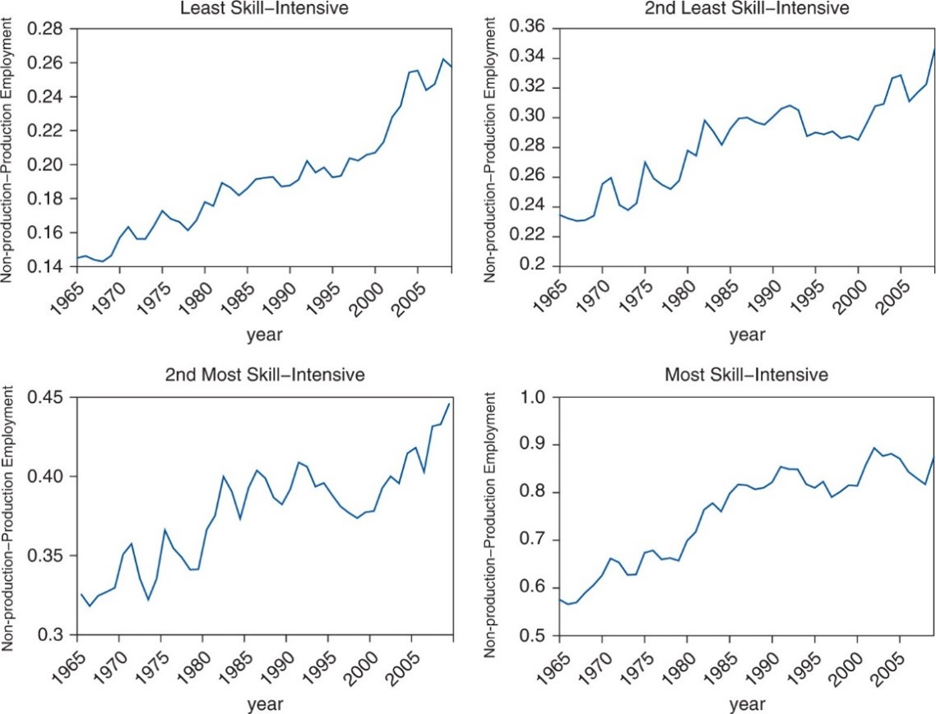
Figure 5.11 Evolution of U.S. Non-Production–Production Employment Ratios in Four Groups of Sectors
Sectors are grouped based on their skill intensity. The non-production–production employment ratio has increased over time in all four sector groups.
Source: N B E R-C E S Manufacturing Productivity Database.
Notes:
The plot for least skill-intensive rises generally from (1965, 0.145) to (2005, 0.25). The plot for second least skill-intensive rises generally from (1965, 0.235) to (2005, 0.32). The plot for second most skill-intensive rises generally from (1965, 0.325) to (2005, 0.420). The plot for most skill-intensive rises generally from (1965, 0.58) to (2005, 0.86). All values estimated.

Slide 52
Capital-Skill Complementarity (1 of 2)
Figure 5.12 shows that the trend toward lower labor income share (and higher capital shares) is a worldwide phenomenon.
Experienced in labor-abundant countries (including China, India, and Mexico) to the same extent as it has been for capital-abundant countries such as the United States.
The evidence supports an explanation based on technological changes within sectors—not increased import competition.

Slide 53
Capital-Skill Complementarity (2 of 2)
Technological change often takes the form of new and better machines (capital) that displace unskilled workers but still require skilled workers.
This generates higher returns for both capital and skilled workers while depressing the returns to unskilled workers.
Increased automation can explain the observed worldwide increases in both wage inequality and the returns to capital, as well as the within-sector increases in the employment share of (relatively skilled) non-production workers.

Slide 54
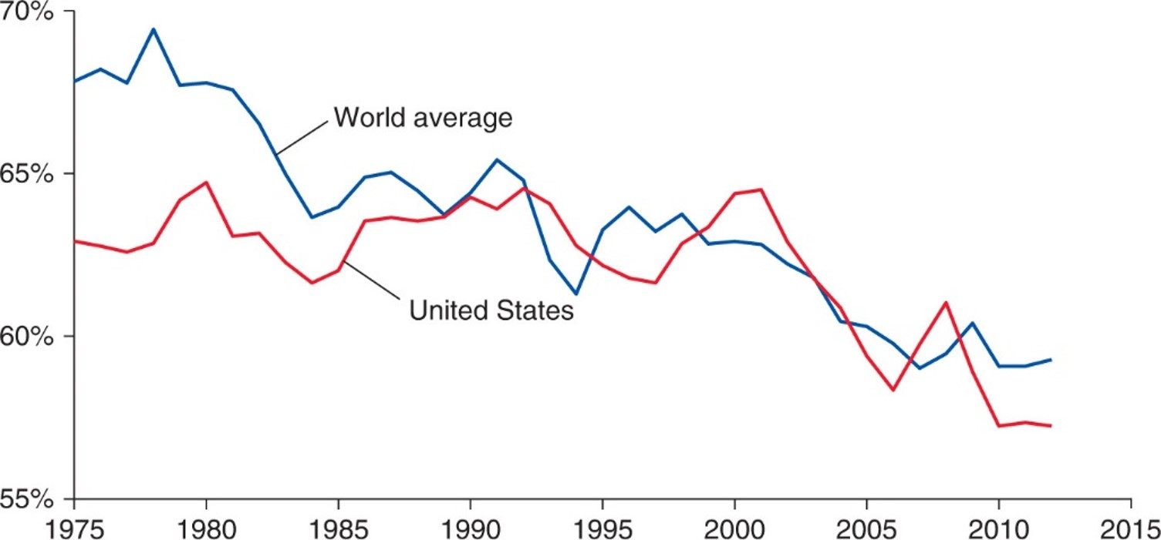
Figure 5.12 U.S. and Average World Corporate Labor Share
Unweighted world average for all 59 countries with available data.
Source: Loukas Karabarbounis and Brent Neiman, “The Global Decline of the Labor Share,” The Quarterly Journal of Economics 129.1 (2014), pp. 61–103.
Notes:
The plot for world average generally falls from 68% in 1975, to 61% in 1995, to 60% in 2012. The plot for the U S generally falls from 63% in 1975 through 62% in 1995, to 57% in 2012. All values estimated.

Slide 55
Factor Price Equalization (1 of 3)
Unlike the Ricardian model, the Heckscher-Ohlin model predicts that factor prices will be equalized among countries that trade.
Free trade equalizes relative output prices.
Due to the connection between output prices and factor prices, factor prices are also equalized.
Trade increases the demand of goods produced by relatively abundant factors, indirectly increasing the demand of these factors, raising the prices of the relatively abundant factors.

Slide 56
Factor Price Equalization (2 of 3)
In the real world, factor prices are not equal across countries.
The model assumes that trading countries produce the same goods, but countries may produce different goods if their factor ratios radically differ.
The model also assumes that trading countries have the same technology, but different technologies could affect the productivities of factors and therefore the wages/rates paid to these factors.

Slide 57
Table 5.1 Comparative International Wage Rates
Country | Hourly Compensation of Manufacturing Workers 2016 (United States = 100)
Switzerland | 154.64
Germany | 110.63
United States | 100.00
United Kingdom | 72.79
Japan | 67.80
South Korea | 58.87
Argentina | 42.97
Greece | 40.22
Portugal | 28.08
Czech Republic | 27.43
Poland | 21.83
Brazil | 20.45
Turkey | 15.61
Mexico | 10.02
Philippines | 5.27
Source: The Conference Board, International Labor Comparisons.

Slide 58
Factor Price Equalization (3 of 3)
The model also ignores trade barriers and transportation costs, which may prevent output prices and thus factor prices from equalizing.
The model predicts outcomes for the long run, but after an economy liberalizes trade, factors of production may not quickly move to the industries that intensively use abundant factors.
In the short run, the productivity of factors will be determined by their use in their current industry, so that their wage/rental rate may vary across countries.

Slide 59
Empirical Evidence on the Heckscher-Ohlin Model (1 of 6)
Tests on U.S. data
Leontief found that U.S. exports were less capital-intensive than U.S. imports, even though the United States is the most capital-abundant country in the world: Leontief paradox.
Tests on global data
Bowen, Leamer, and Sveikauskas tested the Heckscher-Ohlin model on data from 27 countries and confirmed the Leontief paradox on an international level.

Slide 60
Table 5.2 Factor Content of U.S. Exports and Imports for 1962
blank | Imports | Exports
Capital per million dollars | $2,132,000 | $1,876,000
Labor (person-years) per million dollars | 119 | 131
Capital-labor ratio (dollars per worker) | $17,916 | $14,321
Average years of education per worker | 9.9 | 10.1
Proportion of engineers and scientists in work force | 0.0189 | 0.0255
Source: Robert Baldwin, “Determinants of the Commodity Structure of U.S. Trade,” American Economic Review 61 (March 1971), pp. 126-145.

Slide 61
Table 5.3 Estimated Technological Efficiency, 1983
Country | blank
Bangladesh | 0.03
Thailand | 0.17
Hong Kong | 0.40
Japan | 0.70
West Germany | 0.78
United States | 1
Source: Daniel Trefler, “The Case of the Missing Trade and Other mysteries,” American Economic Review (December 1995), pp. 1029–1046.

Slide 62
Empirical Evidence on the Heckscher-Ohlin Model (2 of 6)
Because the Heckscher-Ohlin model predicts that factor prices will be equalized across trading countries, it also predicts that factors of production will produce and export a certain quantity goods until factor prices are equalized.
In other words, a predicted value of services from factors of production will be embodied in a predicted volume of trade between countries.

Slide 63
Empirical Evidence on the Heckscher-Ohlin Model (3 of 6)
But because factor prices are not equalized across countries, the predicted volume of trade is much larger than actually occurs.
A result of “missing trade” discovered by Daniel Trefler.
The reason for this “missing trade” appears to be the assumption of identical technology among countries.
Technology affects the productivity of workers and therefore the value of labor services.
A country with high technology and a high value of labor services would not necessarily import a lot from a country with low technology and a low value of labor services.

Slide 64
Empirical Evidence on the Heckscher-Ohlin Model (4 of 6)
An important study by Donald Davis and David Weinstein showed that if relax the assumption of common technologies, along with assumptions underlying factor price equalization (countries produce the same goods and costless trade equalizes prices of goods):
then the predictions for the direction and volume of the factor content of trade line-up well with empirical evidence and ultimately generate a good fit.
Difficulty finding support for the predictions of the “pure” Heckscher-Ohlin model can be blamed on some of the assumptions made.

Slide 65
Table 5.4 A Better Empirical Fit for the Factor Content of Trade
blank | Assumptions Dropped None | Assumptions Dropped Drop (1) | Assumptions Dropped Drop (1)-(2) | Assumptions Dropped Drop (1)-(3)
Predictive Success (sign test) | 0.32 | 0.50 | 0.86 | 0.91
Missing Trade (observed/predicted) | 0.0005 | 0.008 | 0.19 | 0.69
Assumptions: (1) common technologies across countries; (2) countries produce the same set of goods; and (3) costless trade equalizes goods prices.
Source: Donald R. Davis and David Weinstein, “An Account of Global Factor Trade,” American Economic Review (2001), pp. 1423–1453.

Slide 66
Empirical Evidence on the Heckscher-Ohlin Model (5 of 6)
Contrast the exports of labor-abundant, skill-scarce nations in the developing world with the exports of skill-abundant, labor-scarce (rich) nations.
The exports of the three developing countries to the United States are concentrated in sectors with the lowest skill intensity.
The exports of the three skill abundant countries to the United States are concentrated in sectors with higher skill intensity.

Slide 67
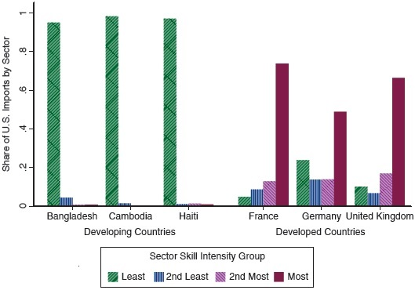
Figure 5.13 Export Patterns for a Few Developed and Developing Countries, 2008–2012
Source: N B E R-C E S U.S. Manufacturing Productivity Database, U.S. Census Bureau, and Peter K. Schott, “The Relative Sophistication of Chinese Exports,” Economic Policy (2008), pp. 5–49.
Notes:
The bar graph plots the share of the U S imports by sector versus six countries, three developing and three developed. Four skill sectors for each country are represented, least skill intensive, second least skill intensive, second most skill intensive, and the most skill intensive. The following list provides share of U S imports, by sector, for each country. Developing countries are as follows. Bangladesh, least, 0.975. Second least, 0.050, second most, 0.001, and most, 0.002. Cambodia, least, 0.99, second least, 0.02, second most, 0.01, most, zero. Haiti, least, 0.98, second least, 0.004, second most, 0.005, most, 0.004. Developed countries are as follows. France, least, 0.060, second least, 0.10, second most, 0.12, most, 0.78. Germany, least, 0.24, second least, 0.12, second most, 0.121, most, 0.48. United Kingdom, least, 0.1, second least, 0.08, second most, 0.18, most, 0.64. All values are estimated.

Slide 68
Empirical Evidence on the Heckscher-Ohlin Model (6 of 6)
Or compare how exports change when a country such as China grows and becomes relatively more skill-abundant:
The concentration of exports in high-skill sectors steadily increases over time.
In the most recent years, the greatest share of exports is transacted in the highest skill-intensity sectors, whereas exports were concentrated in the lowest skill-intensity sectors in the earlier years.

Slide 69
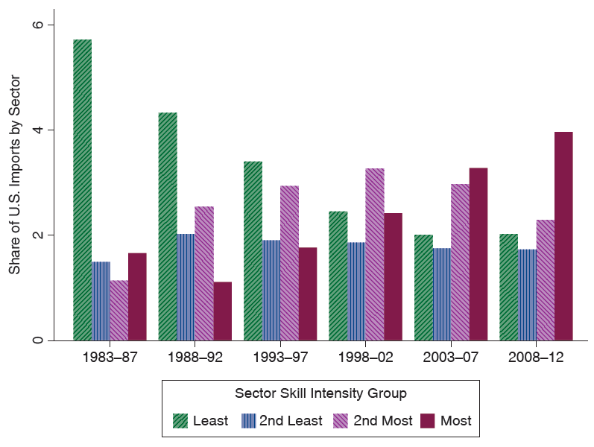
Figure 5.14 Changing Pattern of Chinese Exports over Time
Source: N B E R-C E S U.S. Manufacturing Productivity Database, U.S. Census Bureau, and Peter K. Schott, “The Relative Sophistication of Chinese Exports,” Economic Policy (2008), pp. 5–49.
Notes:
A bar graph plots the share of U S imports by sector versus the years 19 83 to 20 12 for the skill sectors. The following list provides share of U S imports for each sector, by year range. Least skill intensive, 19 83 to 87, 5.8. 19 88 to 92, 4.5. 19 93 to 97, 3.8. 19 98 to 2002, 2.5. 2003 to 2007, 2. 2008 to 20 12, 2. Second least skill intensive. 19 83 to 87, 1.7. 19 88 to 92, 2.1. 19 93 to 97, 2. 19 98 to 2002, 2. 2003 to 2007, 2. 2008 to 20 12, 2. Second most skill intensive. 19 83 to 87, 1.6. 19 88 to 92, 2.4. 19 93 to 97, 3.2. 19 98 to 2002, 3.6. 2003 to 2007, 3. 2008 to 20 12, 2.3. Most skill intensive. 19 83 to 87, 1.8. 19 88 to 92, 1.2. 19 93 to 97, 1.9. 19 98 to 2002, 2.3. 2003 to 2007, 3.3. 2008 to 20 12, 4. All values are estimated.

Slide 70
Summary (1 of 4)
Substitution of factors used in the production process generates a curved P P F.
When an economy produces a low quantity of a good, the opportunity cost of producing that good is low.
When an economy produces a high quantity of a good, the opportunity cost of producing that good is high.
When an economy produces the most value it can from its resources, the opportunity cost of producing a good equals the relative price of that good in markets.

Slide 71
Summary (2 of 4)
An increase in the relative price of a good causes the real wage or real rental rate of the factor used intensively in the production of that good to increase,
while the real wage and real rental rates of other factors of production decrease.
If output prices remain constant as the amount of a factor of production increases, then the supply of the good that uses this factor intensively increases, and the supply of the other good decreases.

Slide 72
Summary (3 of 4)
An economy exports goods that are relatively intensive in its relatively abundant factors of production and imports goods that are relatively intensive in its relatively scarce factors of production.
Owners of abundant factors gain, while owners of scarce factors lose with trade.
A country as a whole is predicted to be better off with trade, so winners could in theory compensate the losers within each country.

Slide 73
Summary (4 of 4)
The Heckscher-Ohlin model predicts that relative output prices and factor prices will equalize, neither of which occurs in the real world.
Empirical support of the Heckscher-Ohlin model is weak except for cases involving trade between high-income countries and low/middle- income countries or when technology differences are included.

Slide 74
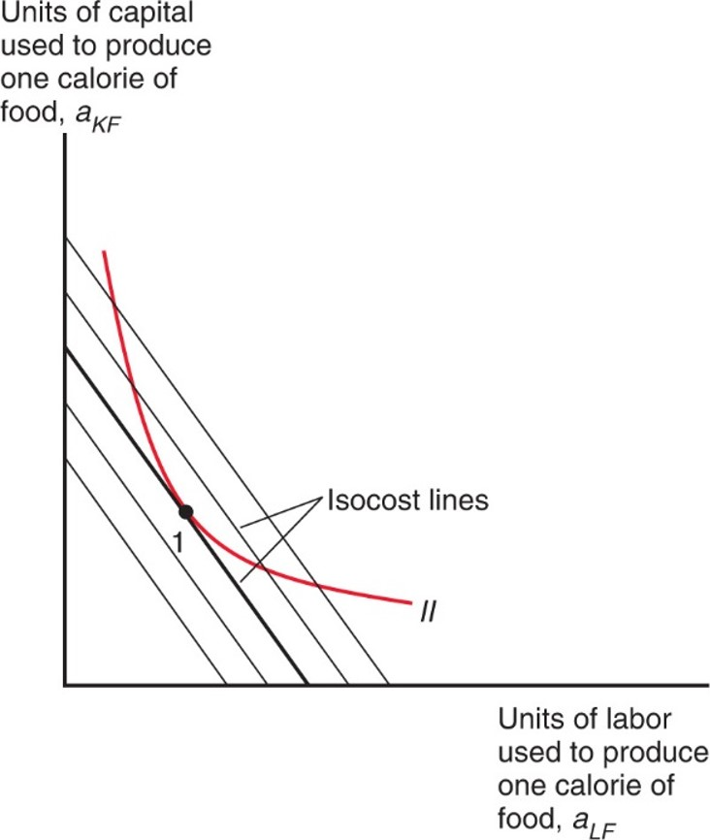
Figure 5A.1 Choosing the Optimal Labor-Capital Ratio
To minimize costs, a producer must get to the lowest possible isocost line; this means choosing the point on the unit isoquant
where the slope is equal to minus the wage-rental
ratio w > r.
Notes:
Curve 2 falls to the right with decreasing steepness through point 1, which intersects an isocost line. 2 additional, parallel isocost lines are to the right of the intersecting line, and 2 to the left.

Slide 75
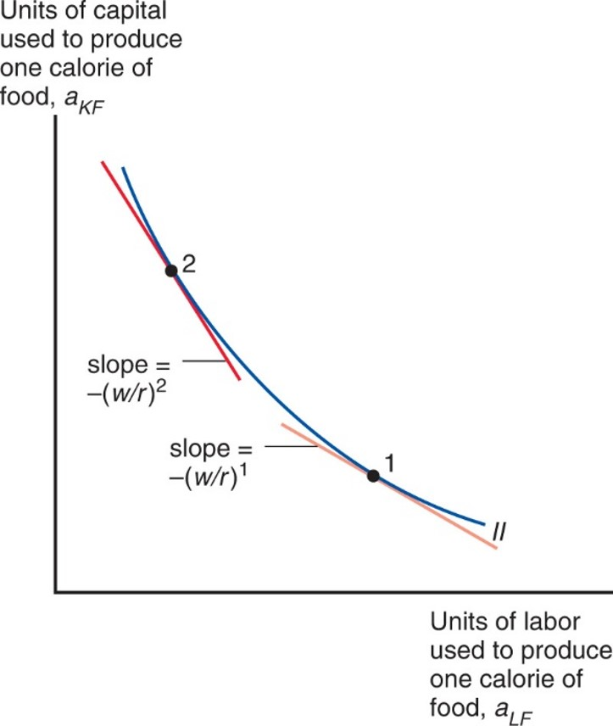
Figure 5A.2 Changing the Wage-Rental Ratio
A rise in w > r shifts the lowest-cost input choice from point 1 to point 2; that is, it leads to the choice of a lower labor-capital ratio.
Notes:
versus units of labor used to produce one calorie of food, ay sub L F. Curve 2 falls with decreasing steepness through point 2, then point 1. At point 2, slop = negative w over r, whole super 2. At point 1, slope = negative w over r, whole super 1. The slope is steeper at point 2.

Slide 76
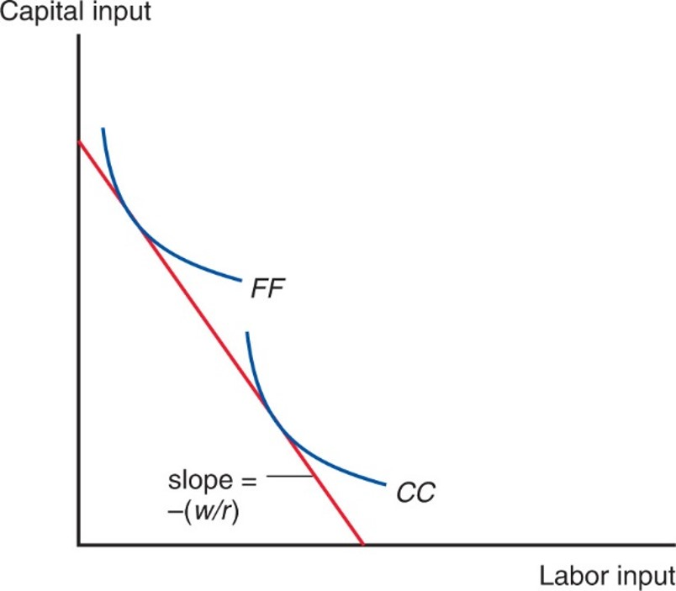
Figure 5A.3 Determining the Wage-Rental Ratio
The two isoquants C C and F F show the inputs necessary to produce one dollar’s worth of cloth and food, respectively. Since price must equal the cost of production, the inputs into each good must also cost one dollar. This means that the wage-rental ratio must equal minus the slope of a line tangent to both isoquants.
Notes:
Curve F F falls with decreasing steepness, above and to the left of curve C C, which also falls with decreasing steepness. A line with slope negative w over r, intersects roughly the midpoint on each curve.

Slide 77
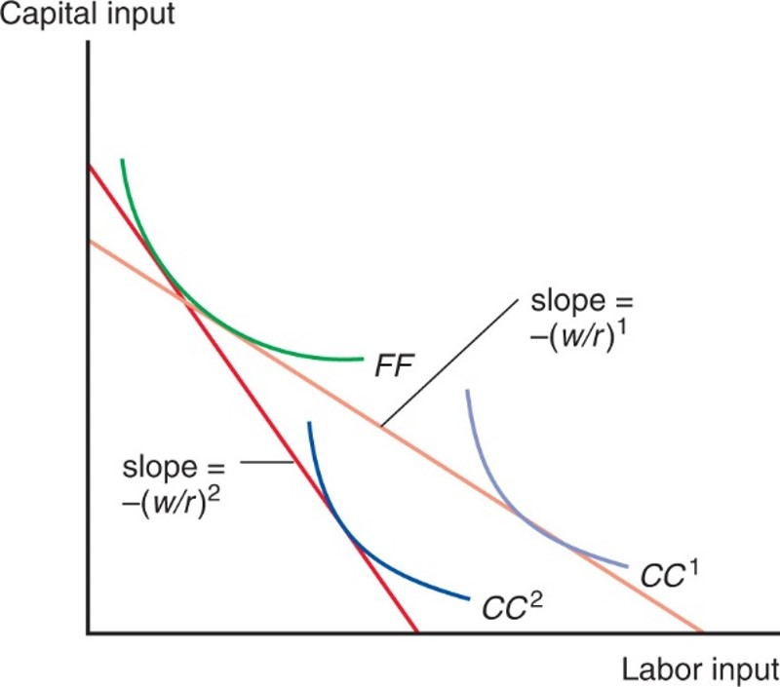
Figure 5A.4 A Rise in the Price of Cloth
If the price of cloth rises, a smaller output is now worth one dollar; so
is replaced by
The implied wage-rental ratio must
therefore rise.
Notes:
Curve F F falls with decreasing steepness, above and to the left of curve C C super 2, which falls with decreasing steepness. Shifted up and to the left of curve C C super 2, curve C C super 1 falls with parallel slope. A line with slope negative w over r, super 2, intersects roughly the midpoint on curve C C super 2. A second line, with a lesser slope of negative w over r, super 1, intersects curves F F and C C super 1 at roughly the midpoint of each curve.

Slide 78

Copyright
This work is protected by United States copyright laws and is provided solely for the use of instructors in teaching their courses and assessing student learning. Dissemination or sale of any part of this work (including on the World Wide Web) will destroy the integrity of the work and is not permitted. The work and materials from it should never be made available to students except by instructors using the accompanying text in their classes. All recipients of this work are expected to abide by these restrictions and to honor the intended pedagogical purposes and the needs of other instructors who rely on these materials.

